Slide 1
PARTNER LIAISON SECURITY OPERATIONS
30th January 2024 – Security Managers Roundtable Workshop
PLSO Resource Links [Click the icons]
PLSO Website
Know-B4U-Go Video
Designing Security Document Systems online tutorial
ISER System
Ask for PLSO Assistance:
Email: copplsonigeria@rsmconsulting.us

Slide 2
Security Risk Rating by State
Sokoto
Katsina
Zamfara
Jigawa
Yobe
Kano
Borno
Kebbi
Kaduna
Bauchi
Gombe
Niger
Adamawa
Plateau
Kwara
Abuja
Key
Nasarawa
Oyo
Taraba
Ekiti
Kogi
Negligible
Osun
Benue
Low
Ogun
Ondo
Enugu
Medium
Lagos
Edo
Ebonyi
Cross River
High
Delta
Anambra
Imo
Extreme
Akwa Ibom
Bayelsa
Rivers
Abia

Slide 3
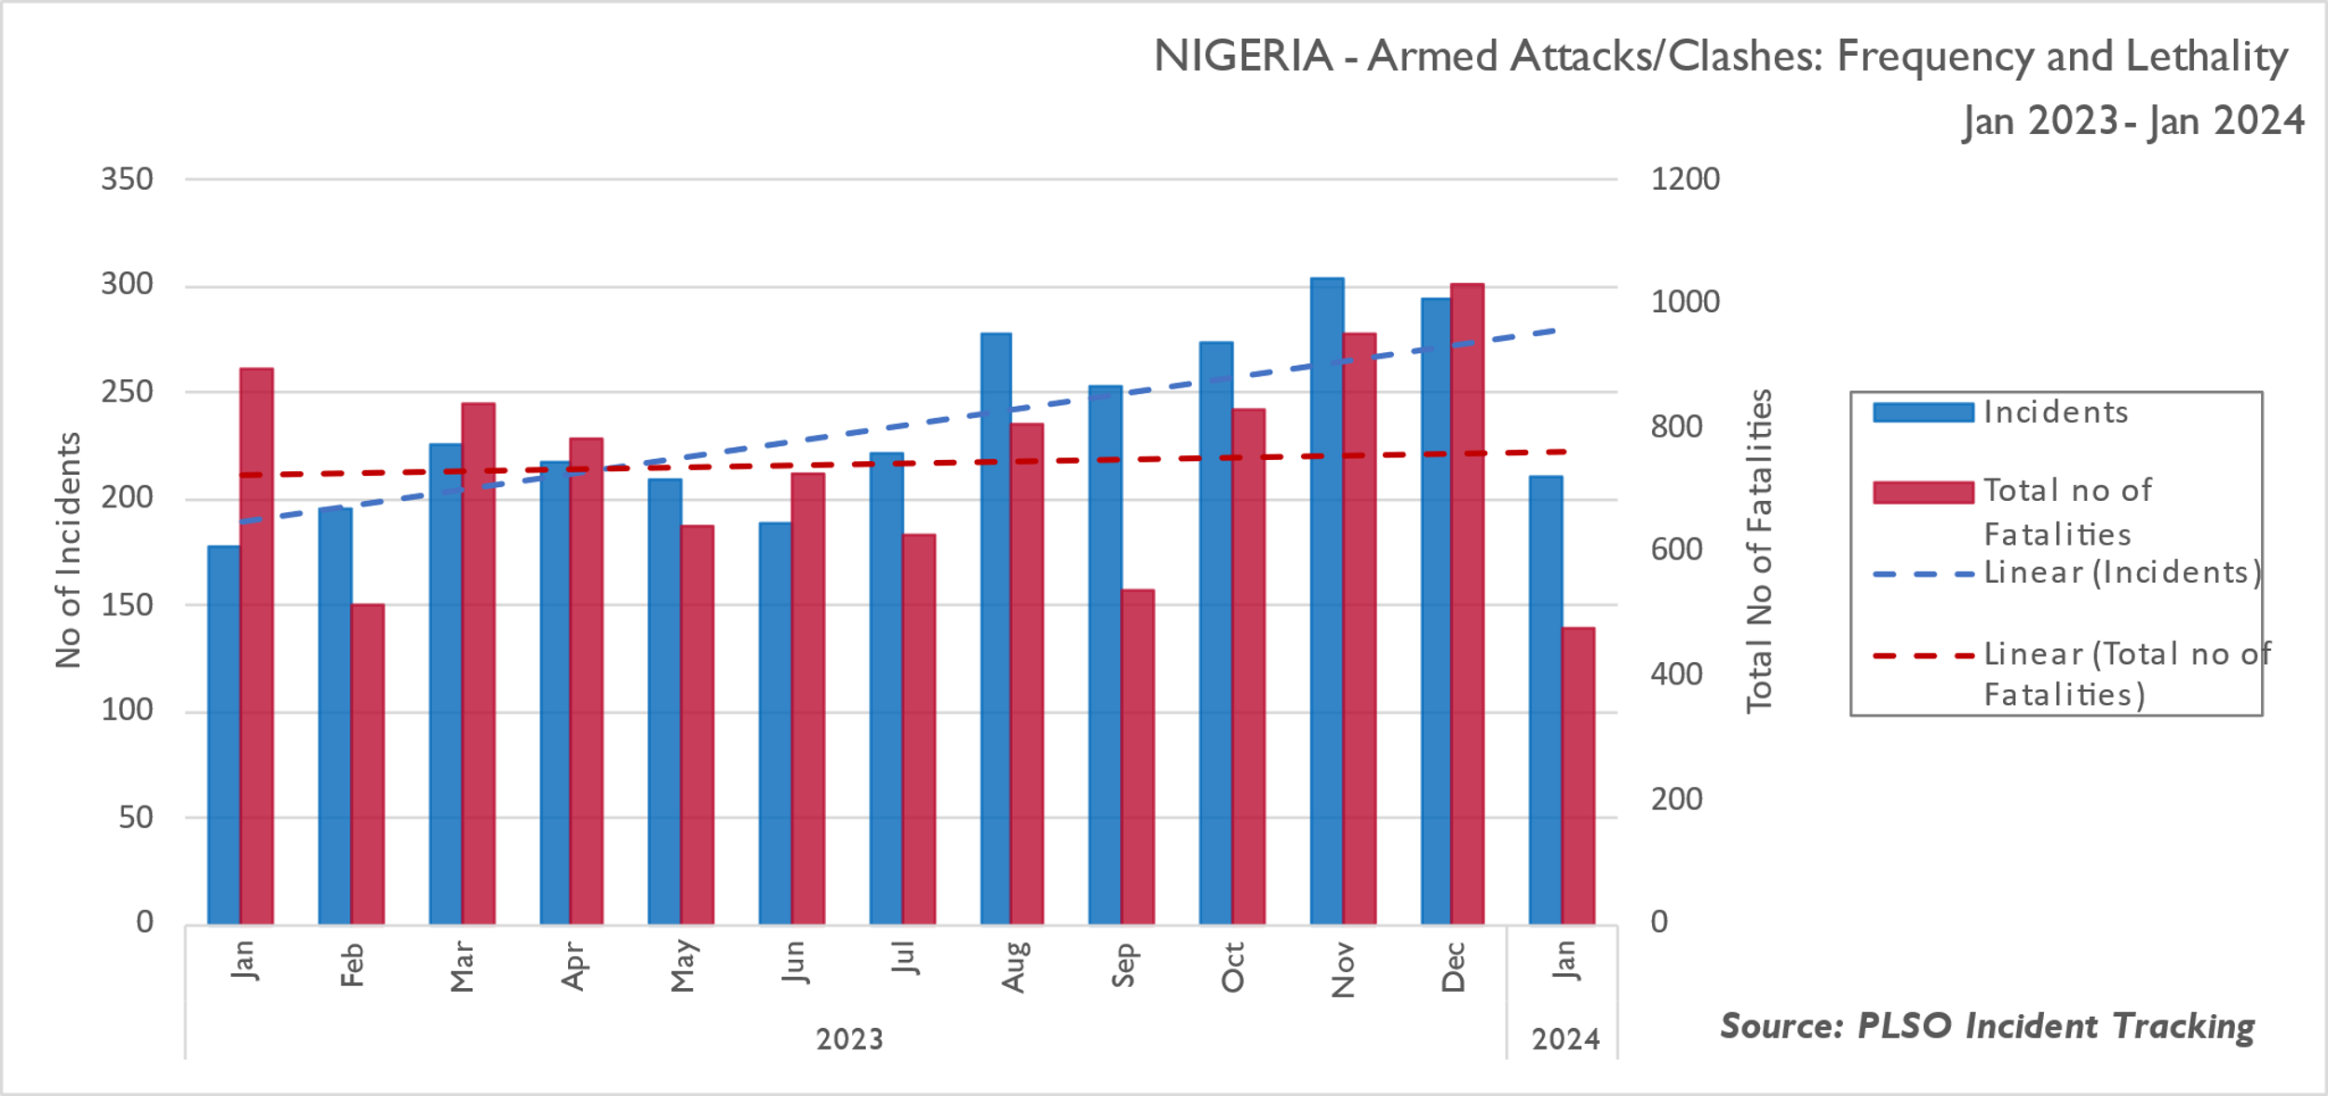
Nationwide Trend Analysis: Armed Conflict
Armed attacks remain a prevalent security threat, particularly in the northern regions, and are mostly attributed to bandits, insurgents, and the herder/farmer conflict. The highest fatalities per state reported this month were reported in Borno, Plateau, and Katsina States. A resurgence of localized clashes which began in Dec23 and intensified in Jan24 led to high fatalities in Plateau State. Despite a 24-hour curfew imposed by the State Government, the violence persisted leading to loss of lives and vandalization of properties. IPs suspended operations in the affected LGAs.
Notes:
Plateau State and violent clashes
Sit-at-home exercise in S/E

Slide 4
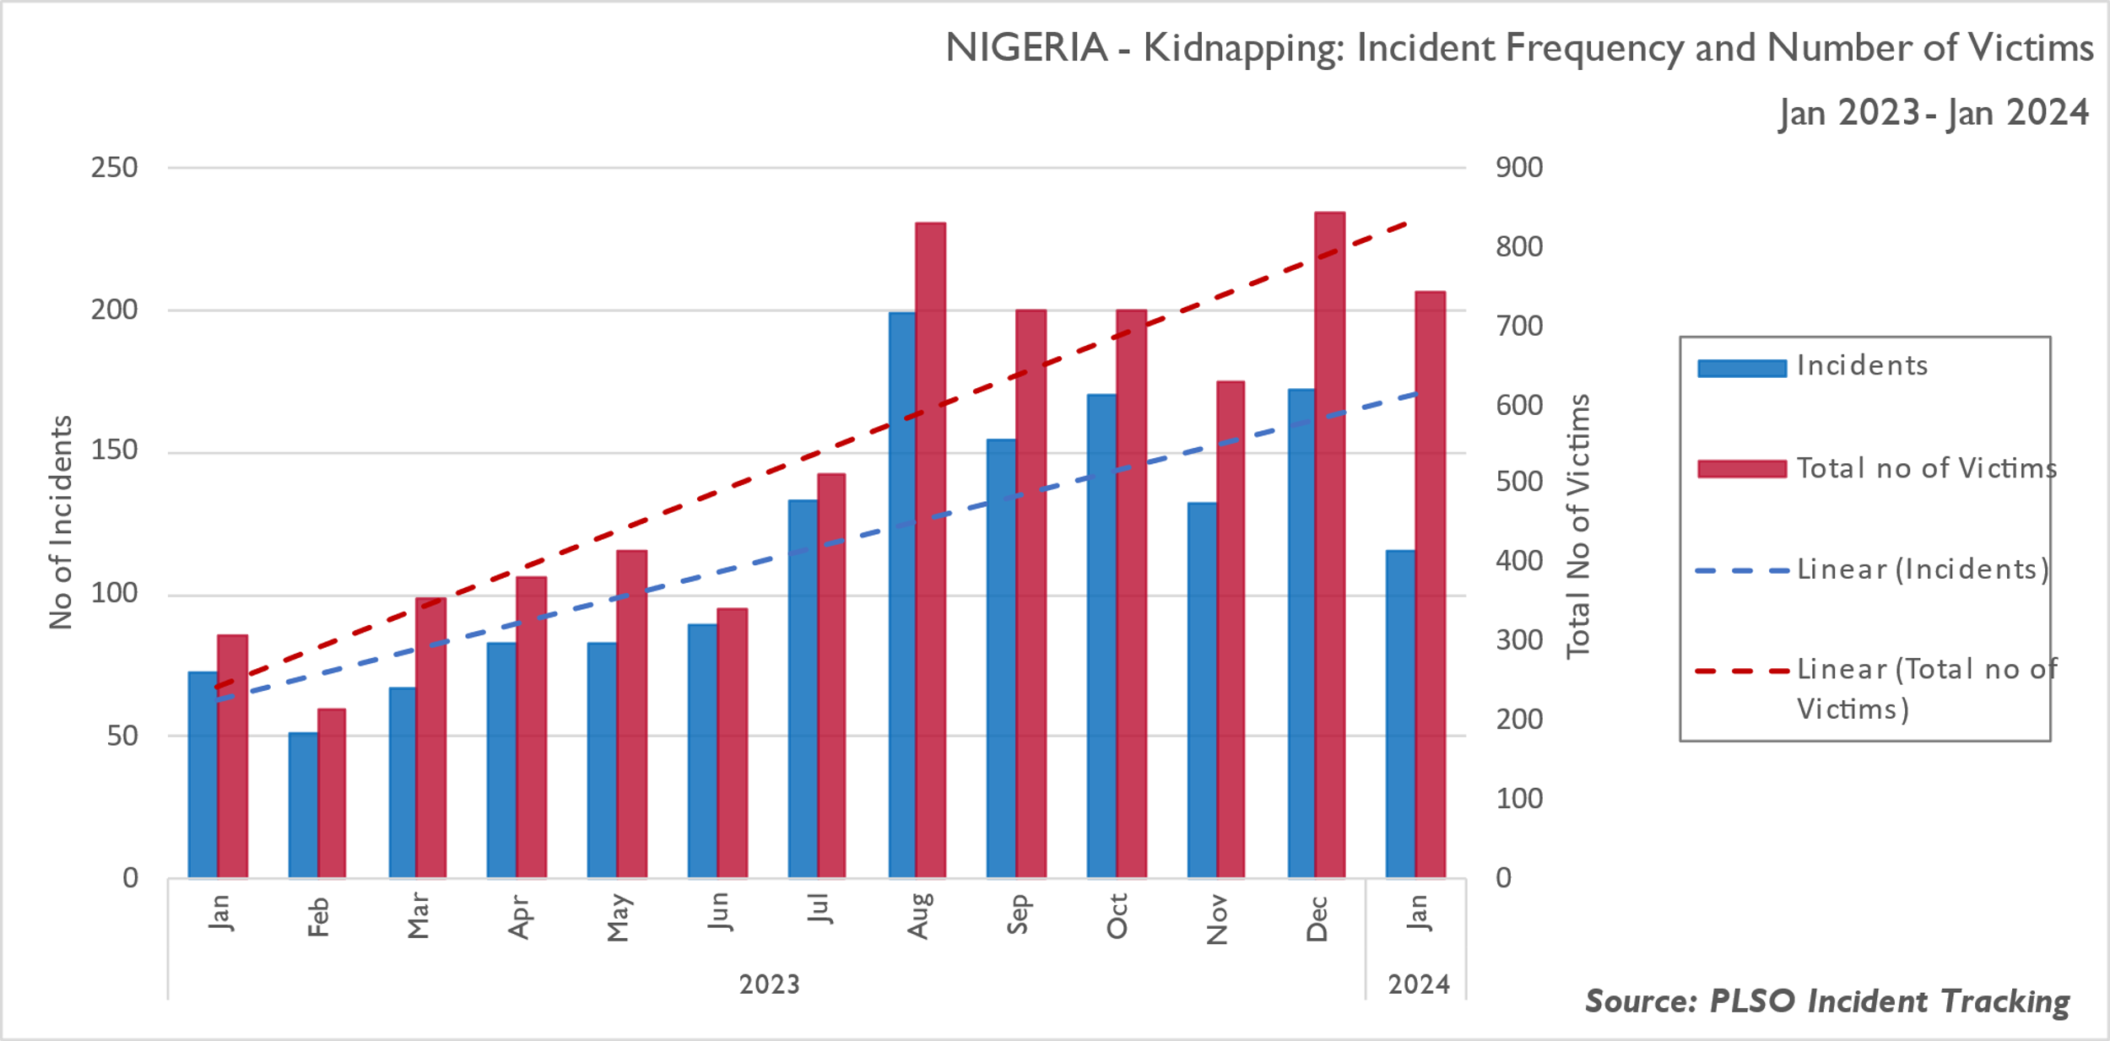
Nationwide Trend Analysis: Kidnapping
Mass abductions, notably in the North West and the Middle Belt, and targeted kidnapping in many parts of the country continue to plague Nigeria, with the brunt borne by the local national community. The very high number of kidnap victims recorded in Borno, Niger, Kaduna, Katsina, and Zamfara States are attributable to continued mass abductions carried out by insurgents and bandit gangs. This reporting month, of the 745 abducted victims, 431 (59%) were abducted in the North West region followed by 168 (23%) in the North Central region and 100 (13%) in the North East region. Zamfara State recorded the highest number of kidnapped victims (174) followed by Katsina State (126) and Kaduna State (111).
Notes:
Three incidents with more than 50 abductees in Zamfara State
Kidnap in Abuja - 43

Slide 5
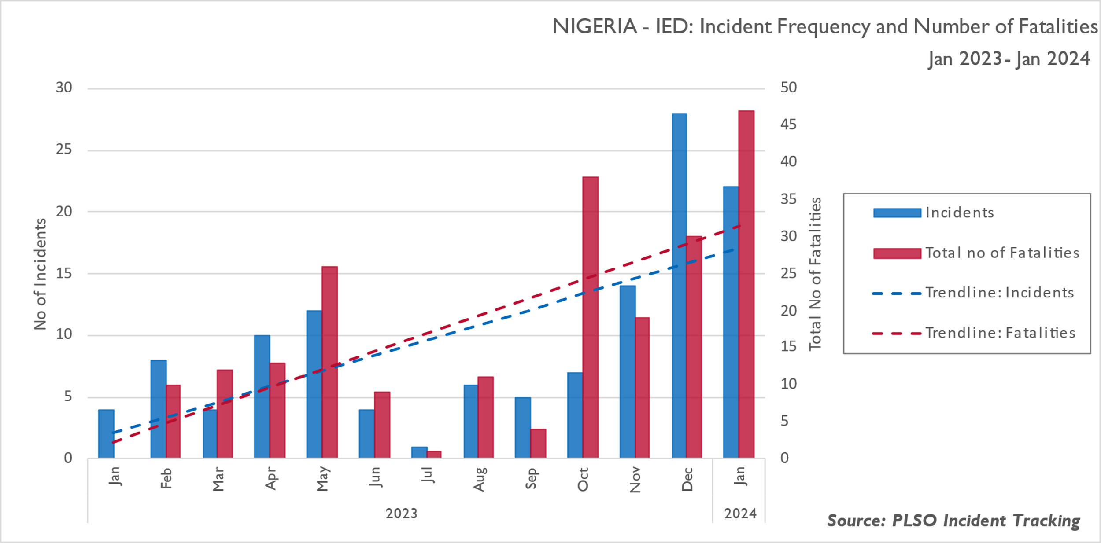
Nationwide Trend Analysis: IED Frequency and Fatalities
This reporting period has seen a decrease in reported fatalities emanating from explosive incidents or accidents compared to December. This month, so far, 21 incidents were reported in Borno State and one in Yobe State resulting in 47 fatalities. In Yobe State, one vigilante was killed following an IED explosion in Geidam LGA. Insurgents deploy IEDs along MSRs as an effective area weapon to target GSF personnel, and civilians – including humanitarian aid and development sector organizations transiting these routes – in the North East region.

Slide 6
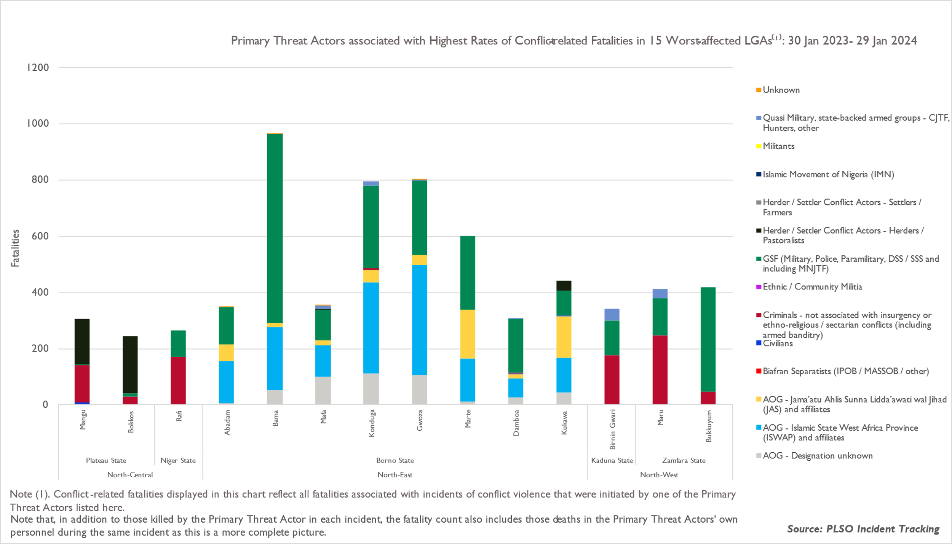
Primary Threat Actors: 15 worst-affected LGAs
The chart illustrates the high number of fatalities resulting from intensified and concentrated military operations targeting insurgents, bandits, and other criminals at their hideouts and logistics bases in the forested areas across the country. The clashes between ISWAP and JAS have further contributed to high fatalities in Borno State. Similar clashes and direct attacks are likely in the short term and the threat to civilians (including aid workers) remains. Of the 669 reported fatalities in Jan24, 97 (14%) fatalities were criminals and insurgents killed during military operations. While bandits’ and insurgents’ activities are responsible for the worsening security conditions in the North West and North East regions respectively, the activities of organized criminal gangs and localized clashes are the most reported incident type in Benue and Plateau States.

Slide 7
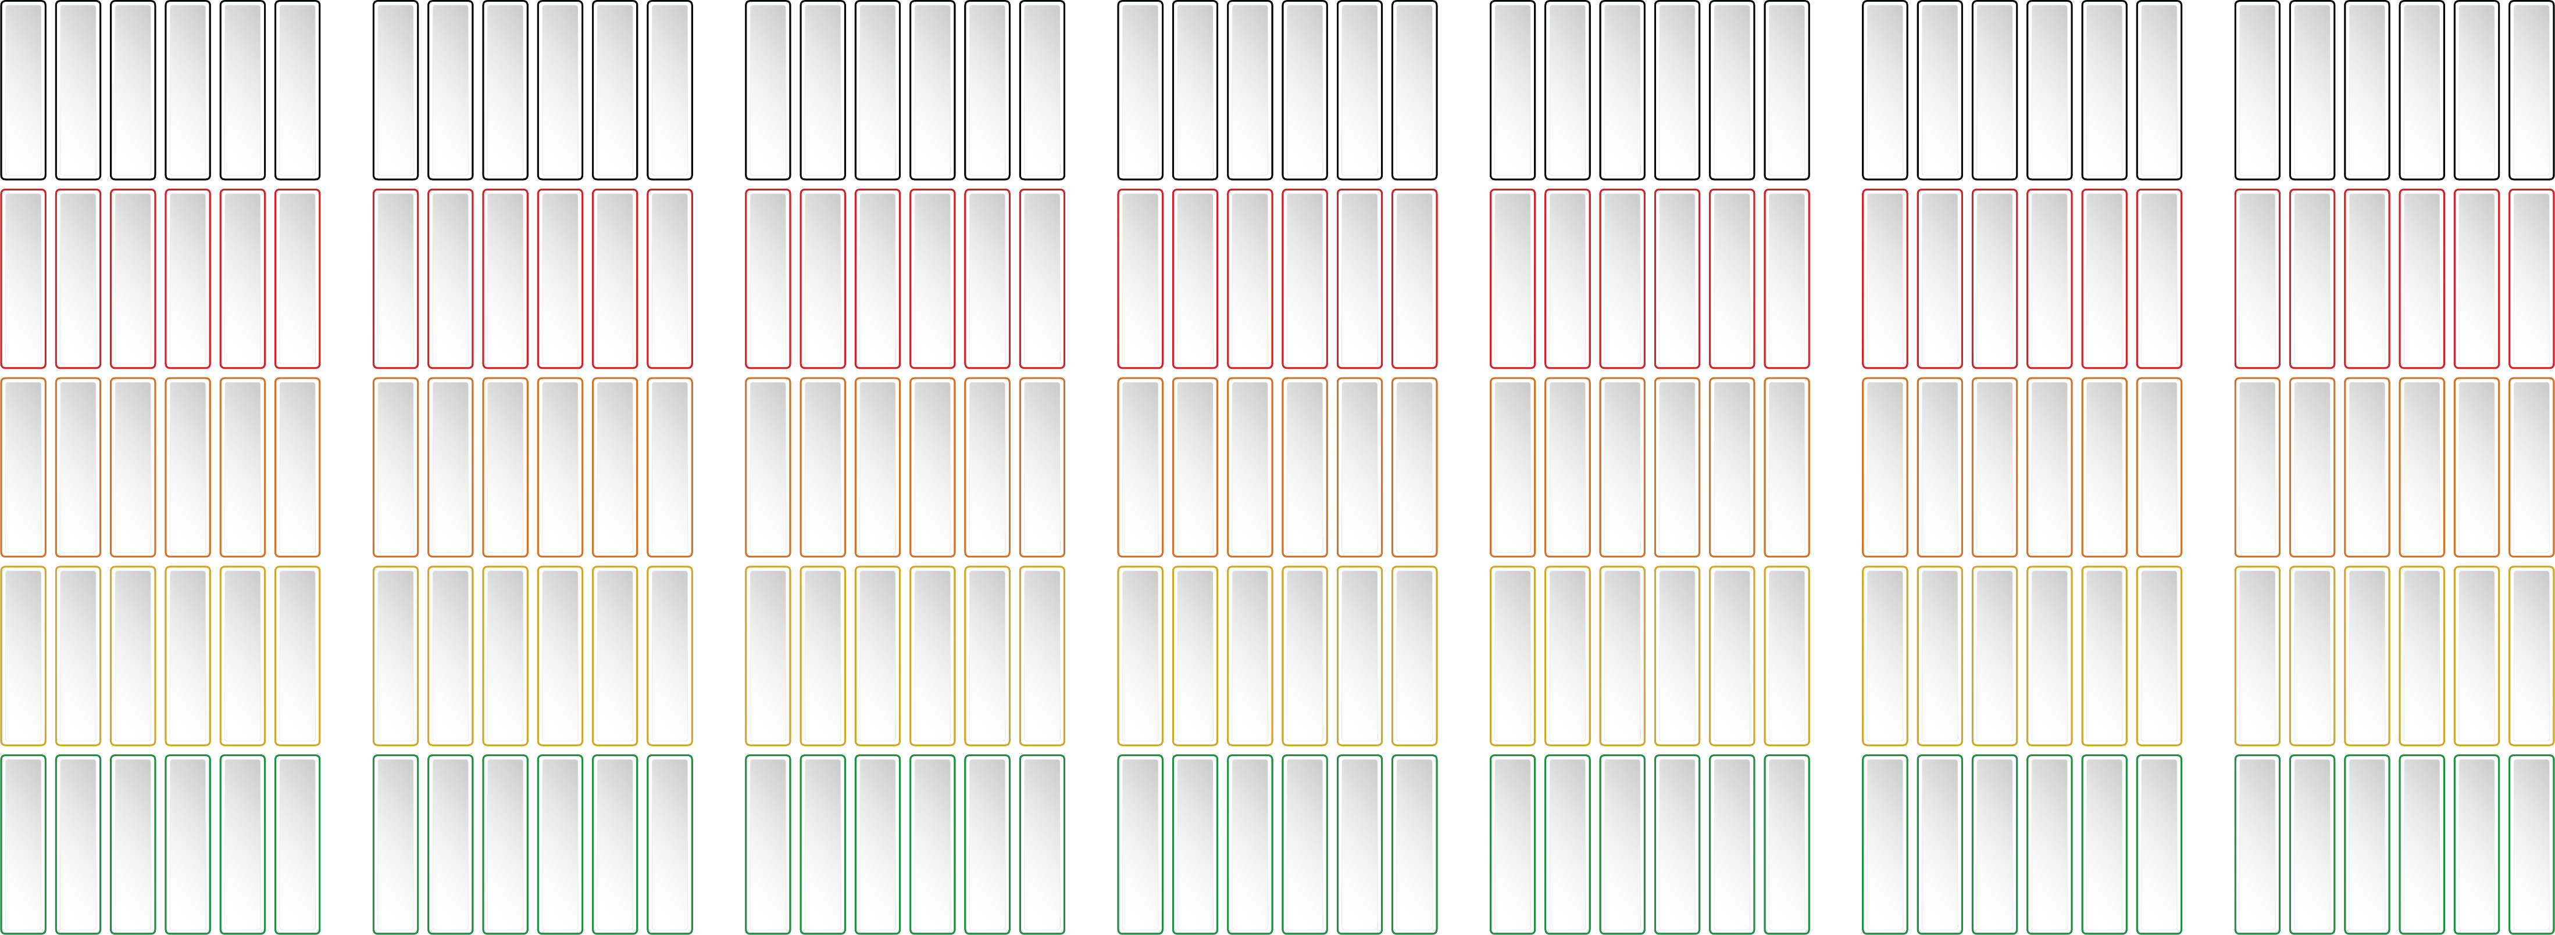
Threat Factors and Actors
Extreme
High
Medium
Low
Negligible
South East
North East
South East
North East
South East
North East
South East
North East
South East
North East
South East
North East
South East
North East
South West
North West
South West
North West
South West
North West
South West
North West
South West
North West
South West
North West
South West
North West
South South
North Central
South South
North Central
South South
North Central
South South
North Central
South South
North Central
South South
North Central
South South
North Central
Cultism
Criminals and
Gangs
IPOB
Herder / Farmer Clashes
Ethnic Militia
AOGs/Insurgents
Bandits

Slide 8
PLSO | Forecast of Events
Mon 29 Jan | Tue 30 Jan | Wed 31 Jan | Thu 01 Feb | Fri 02 Feb | Sat 03 Feb | Sun 04 Feb
 | SFP Roundtable Virtual – 2pm
Mon 05 Feb | Tue 06 Feb | Wed 07 Feb | Thu 08 Feb | Fri 09 Feb | Sat 10 Feb | Sun 11 Feb
Field Visits Benue - Delta | Field Visits Benue – Delta Staff Safety and Security Awareness Virtual – 10am | Field Visits Benue - Delta | Field Visits Benue – Delta Situation Reporting In-Person – 10am | Field Visits Benue - Delta
Mon 12 Feb | Tue 13 Feb | Wed 14 Feb | Thu 15 Feb | Fri 16 Feb | Sat 17 Feb | Sun 18 Feb
 | Safe Driver Training Virtual - 10am
Mon 19 Feb | Tue 20 Feb | Wed 21 Feb | Thu 22 Feb | Fri 23 Feb | Sat 24 Feb | Sun 25 Feb
Field Visits Kano State | Field Visit Kano State SFP Level 2 In-Person – 10am | Field Visit Kano State CoP Level 2 In-Person – 10am | Field Visit Kano State | Field Visit Kano State

Slide 9
Field Visit - Considerations
1. Pre-Deployment actions:
Conduct Security Risk Assessment of location to be visited.
Identify the risks, assess the risks, treat the risks.
Risk assess the route, plan alternative routes, identify safe havens and choke points.
Conduct vehicle first parade service.
Ensure driver is fit and healthy.
Ensure MOPOL are included in the pre-deployment security briefing.
Rehearse the team deploying to field on the following Actions-ON : Road Traffic Accident, Illness, Vehicle Breakdown, IVCP, Military Check Points, Armed Aggressor during road move and during the field visit.
Ensure MOPOL are included in all rehearsals with team (if used).
Do not wear branded clothing.
Remove branding and logos from vehicles.
2. Consider the following:
Maintain situational awareness.
Route variance.
Stagger arrival, departure and camp exit/entry times.
Do not establish a pattern or routine.
Avoid choke points during road moves.
Consider: The absence of the normal – The presence of the abnormal.
Consider Hostile Reconnaissance.
Consider: Can travel be avoided?
3. Journey Management Planning (JMP)
Use local drivers.
Identify route and alternative routes.
Ensure the JMP includes Emergency Contact Details for the following: Logistics, SFP, GSF, Community Liaison, other stakeholders to include Security, Vehicle Breakdown service, medical, LGA contact.
Ensure drivers take frequent breaks at known safe havens and follow established check-in protocols.
In-Vehicle Monitoring System (active and who is monitoring the road move).
Ensure the JMP is approved by senior management.
4. Conduct during Field Trip
Secure your vehicles, drivers to always remain with vehicles.
Inform Security Management of your arrival in the field.
Always maintain situational awareness.
Identify safe havens, local police stations and others.
Ensure drivers know the routes to local safe havens and hospitals.
Always maintain contact with community representatives and liaison officers.
In the event of a security incident, send an immediate SITREP to country management team and PLSO, so that we can alert other IPs in the area.
Inform security management when you depart the field.
5. Post visit actions
Update on security conditions
Update on threat actors

Slide 10
Conflict Awareness
1. Conflict Situations:
Inter-Communal Conflict
Ethno-Religious Conflict
IPOB and the enforcement of the Stay-at-Home instruction
Attacks on GSF personnel
Herder/Farmer Conflict
Abductions on Mass Transit Routes (Airports/Railways)
Abductions on Main Supply Routes
Kidnapping on commuter routes
School and Home invasions
Banditry
Attacks and looting of warehouse supplies
Civil Disorder
GSF personnel static checkpoints and demands for payment
Armed attacks by AOGs on Humanitarian HUBS
Suspension of UNHAS flights
Attacks by AOGs on IDPs
Criminal Gangs
Politically motivated violence
Cult Activity
Destruction of Crops and acquisition of local resources by Herders
Food insecurity leading to protest action by communities
1. Identify the Conflict, and plan mitigation process:
Maintain relationships with communities
Brief teams before deployment
If time allows, rehearse teams on actions they should carry out if there is an incident
Delay implementation until the conflict is resolved
Conduct a Security Risk Assessment before re-deployment
Conduct of Security Risk Assessments on facilities/compounds/warehouses
Identify the triggers that contribute to conflict
Sensitization
Staff Safety and Security Awareness
Introductions to local community elders
Introductions to local religious leaders
Use of community volunteers
Provision of weekly security briefings
Monitoring of local media
Development of information sharing groups
Inclusion on information sharing groups such as the PLSO
Discussion with local staff from communities to understand the security conditions
Emergency Planning
Evacuation Planning
Maintaining Communications
Alternative Communications

Slide 11
Source:
Sources: The PLSO team draw the information contained in this report from multiple sources, to ensure as far as is practically possible, information is validated through triangulation/corroboration. Sources include: UNDSS, curated datasets provided by the Armed Conflict Location and Event Data Project (ACLED) www.acleddata.com, the Aid Worker Security Database (AWSD), Intelligence Fusion, ad hoc security reporting, as well as peer security risk management professionals, international commercial organizations, the media, and host nation government.

