Slide 1
Security Risk Assessment (SRA)
Table of contents
Introduction
Aim of the presentation
Definition of SRA
Objectives of SRA
Security Risk Assessment Stages
Security risk management responses
Risk Matrix Calculation
Periodicity
Cycle of the SRA
Approval Process

Slide 2
The Security Risk Assessment
- An Introduction-
Notes:
Since the beginning of the 21st century, particularly during the first decade, incident affected humanitarian agencies have started increasing the collation and distribution of various aid workers reports. Humanitarian Aid and Development (HAD) worker reporting includes but is not limited to terrorism, mass abduction, piracy, cybercrime, and natural disasters. The failure to act, when risk, and or threats have been identified, can have a devastating impact on the HAD worker community.
To support humanitarian needs, international NGOs, the UN, as well as other institutions intervene. Irrespective of their nature, mission or vision and sector of intervention, they conduct security risk assessments prior to any intervention. For some organizations, they conduct multisectoral assessments and others conduct exclusively the security risk assessment. The latter which is the keystone of all program , enables program managers/officers to understand actual, potential and future threats that can affect staff, assets, the program and the reputation of an organization. The process is unique for each organization and benefits the entire NGO community.
Security is a vital responsibility of all NGO personnel; while absolute security can never be guaranteed, threats and their associated risks can be mitigated, and vulnerabilities reduced once identified and assessed. A formalized security risk management process is the key to accomplishing this vital function.

Slide 3
II. Aim of the presentation
This presentation to:
- Provide a better understanding of the concept of a Security Risk Assessment (SRA)
- Understand the process of conducting a Security Risk Assessment
- Appraise the tools used in conducting a Security Risk Assessment
- Analyze the techniques applied for Security Risk Assessment
- Discuss when to conduct a Security Risk Assessment
- Understand the security risk management approval process

Slide 4
III. Definition of an SRA
The process of identifying threats that could affect personnel, assets or operations and the NGO’s vulnerability to them, assessing risks to the NGO in terms of likelihood and impact, prioritizing those risks and identifying mitigation strategies and measures.
A security risk assessment is a continuous process that allows the organization to monitor and update the current snapshot of threats and risks to which it might be exposed.
It is a tool used to identify, assess, and implement key security controls in applications to ensure the successful delivery of program activities.
The process of identifying those threats that could affect personnel, assets or operations and our vulnerability to them, assessing risks to us in terms of likelihood and impact, prioritizing those risks and identifying mitigation strategies and measures.

Slide 5
III. Definition of SRA
Ongoing assessment. As part of your normal routine, you should continually assess the security situation, watching out for changes which could affect the security of staff or property and adjusting operating procedures accordingly.
Emergency assessment. In a fast-moving emergency you may have only a few moments to assess the situation before making a life-or-death decision. Taking those few moments to assess should help you to make the right decision.

Slide 6
Characteristics of the SRA
It fills the following characteristics :
It is a living document and requires a participative approach
It is a contextualized document
It is a concise and objective document
It is both a security and a programmatic tool
It is also a decision-making tool
It is written in a digest manner
It reflects the prevailing security threats/risks in a particular environment
Lastly, it is subject to change if the situation changes too.

Slide 7
IV. Objectives of the Security Risk Assessment (SRA)
Security risk assessments are conducted to :
Understand the situation in which an organization is going to implement project/program.
Identify the actual and potential risks/threats to an organization
Determine how to mitigate those risks/threats.
Decide whether the situation is sufficiently safe for to implement.
Decide which security documents should be in place: operating procedures, contingency plans and other security measures depending on the country/region and risk rating.
It enables you to determine the country risk rating/level.
Enable the development of appropriate mitigating measures for implementing safe and sustainable programmes.

Slide 8
V. Security Risk Assessment Stages
The stages of a full security assessment are program assessment, threat assessment, vulnerability assessment, mitigating measures and risk rating

Slide 9
Program Assessment
Notes:
This should assess organizational programme from a security point of view and should consider the security implications of the existing or future organizational program. The program assessment must be developed as a collaborative effort between the country directors, program directors, and national staff members (usually the program officers) who will conduct the programs and security, advisers (including security officers where present) in order to ensure mainstreaming of security at the earliest stage of Country/Area Program Operations Planning. It is critical that security focal points are consulted early in all activity assessments prior to grant submission or program development to ensure that threat mitigation decisions are identified and included in grant proposals for proper funding of security training, insurance coverage, emergency equipment, and administration to avoid delays in programs implementation.

Slide 10
Threat assessment:
Once the organization has identified the types of threats that it will face, it will need to evaluate each of them and rate the level of risk to the staff, the overall organization and its operations. Once each threat is listed and all risk is identified, it is important to rate all risks. This helps clarify how severe (or not) the risk is and how much priority it must be given.
Vulnerability assessment:
This stage identifies the strengths and weaknesses of the NGO ‘s security arrangements in the environment in which the organization conducts its activities. It contains two steps : determine the strengths as well as the weaknesses
Mitigation measures.
It refers to the act of identifying factors of the operational context to produce a favourable change in the situation enabling the effective and efficient conduct of activities while ensuring the security, safety, and well-being of staff as a high priority.Measures to reduce risk should focus on both prevention (reduce the probability) and reaction (reduce the impact). By doing this it can reduce the level of residual risk from the level originally assigned to each threat identified and thereby improve your ability to deliver emergency response programmes.
NB: It is good to note that, we cannot eliminate risk, you can only minimize it. Therefore, risk zero does not exist, IFDC should develop strategies enabling her to cope with these threats.

Slide 11
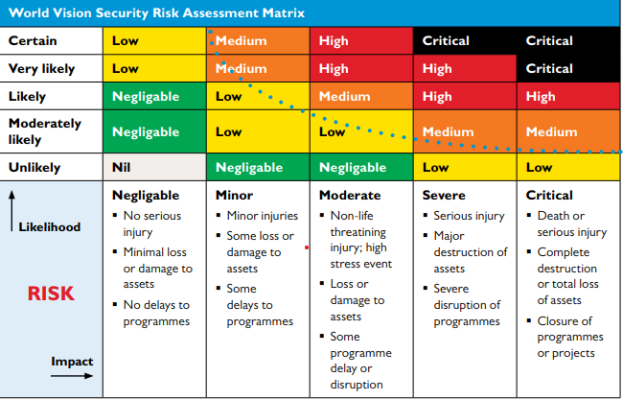
Risk Matrix
The risk matrix is based on two intersecting factors: the likelihood that the risk event will occur, and the potential impact that the risk event will have on the business. In other words, it’s a tool that helps you visualize the probability vs. the severity of a potential risk.

Slide 12
Description of Risk Level and management response
Negligeable | There is a minor risk of harm to staff, assets or programmes. The risk is acceptable in all situations. | No response is required; continue to monitor situation.
Low | There is some risk to all staff, assets or programmes. The threats are indirect, and the impact of any event will not significantly affect operations. The risk is acceptable when managed by ‘Standard Operating Procedures’. | Manage by ‘Standard Operating Procedures’. Effort should be made to reduce probability, or impact, of the event occurring. Review security procedures and management responsibility.
Medium | There is a significant risk to staff, assets or programmes from indirect, or direct, threats. The operational context may change quickly and requires intentional management. The risk may be unacceptable in some circumstances. | Management responsibility must be specified. Significant effort must be made to reduce the probability of the event occurring or reduce its impact. Will require specific contingency planning to ensure safety of staff.
High | There is a severe risk to staff, assets or programmes. The operational context is volatile and unpredictable. The risk is unacceptable in most circumstances. | Senior management action required without delay. Every available effort is required to reduce the probability, or impact, of the event occurring. Significant and specific security measures must be in place to protect staff & assets.
Critical | There is an extreme risk to staff, assets or programmes. The operational context is extremely dangerous and security measures have little or no effect. The safety of staff cannot be guaranteed. The risk is unacceptable in all but the most exceptional circumstances. | Immediate and decisive action by senior management required. The organisation must take immediate and extreme measures to protect itself.

Slide 13
Description | Impact Definitions
Negligeable | The consequences may result in minor disruption to programmes.
Minor | The consequences may result in some minor injuries to staff, possible damage or some loss of equipment and facilities and limited delays to programmes.
Moderate | The consequences may result in injury to staff, significant loss of equipment and facilities and delays to programmes.
Severe | The consequences result in severe injury to staff, significant loss of equipment and facilities and major delays or cancellation of programmes.
Critical | The consequences are catastrophic, resulting in the death or severe injury of staff, major loss of equipment and facilities and cancellation of programmes.

Slide 14
Description | Likelihood Definitions
Unlikely | The event is considered as not having a realistic probability of occurring.
Moderately likely | The event is considered as having a reasonable probability of occurring.
Likely | The event is considered as having a high probability of occurring.
Very Likely | The event is considered as having a very high probability of occurring.
Certain/ imminent | The event is considered imminent and will occur.

Slide 15
Analytical Tools : PESTLE and SWOT for SRA
To conduct a security risk assessment, there is need to use either PESTLE or SWOT analytical tool. They are highly effective analysis tools to help you during the process of SRA and can be used in isolation, however become significantly more effective when used in combination.
PESTLE analysis considers the broad environmental context that affects the business and the changes that occur in this context.
PESTLE analysis forces an organization to consider a wide variety of variables in the greater operating environment. By doing so, it allows the organization to uncover potential risks in areas that you may have otherwise ignored. To understand this, it’s helpful to look at how risks can be found in each of the six PESTLE categories: Political, Environmental, Sociocultural, Technological, Legal and Environmental.
It’s important to note that PESTLE analysis usually takes into account both positive and negative factors affecting a business. However, in the case of risk management, it’s the negative factors which are most interesting.

Slide 16
VI. Security Risk Assessment Tools
There are numerous tools used to conduct a SRA, but generally international NGOs, make use of the two major ones: PESTLE and SWOT:
PESTLE analysis is used to understand the possible impact of the external environment on a project or programme.
It studies the key external factors (Political, Economic, Sociological, Technological, Legal and Environmental) that influence an organisation. It can be used in a range of different scenarios, and can guide people professionals and senior managers in strategic decision-making
NB: If combined, PESTLE analysis is usually completed first to provide a context for the SWOT analysis.

Slide 17
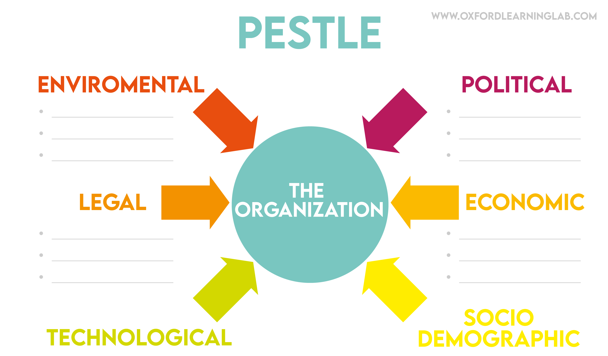

Slide 18
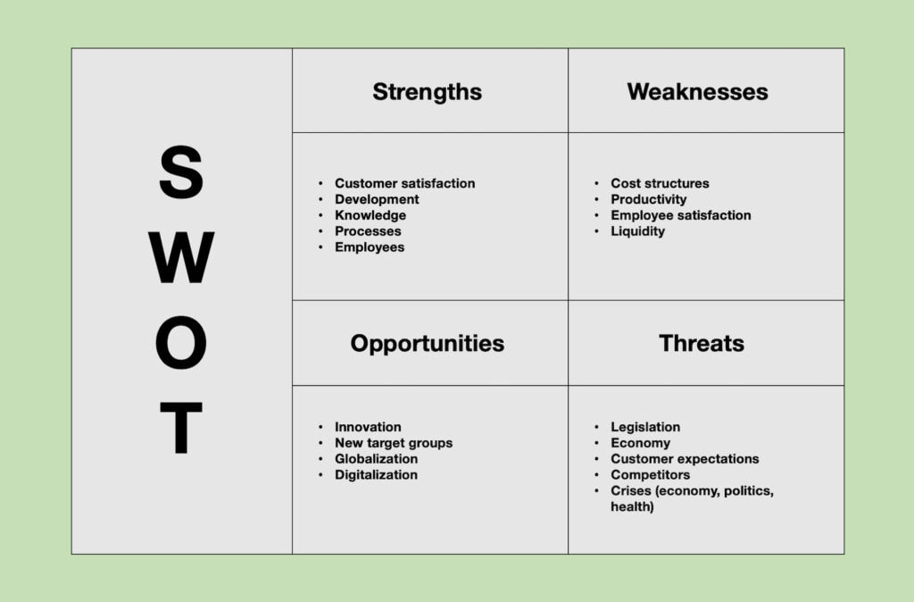
SWOT Aanalysis : It interprets these findings for the business to determine the strengths and weaknesses, and opportunities and threats. It's a great analytical tool to use in a group - either in a facilitated session or as a brainstorm . This method is very helpful for identifying risks within the greater organization context.

Slide 19
VII. Security Management Response
There are many risk management, response, but mostly these responses can be listed into for main one: avoidance, acceptance, transference and mitigation.
Avoidance :
It is the process of reducing the probability of risk. It is a strategy that completely circumvents the likelihood of the risk occurrence by the organization refusing to accept it. This is usually done by refusing to engage in activities that have been identified to present the possible risk. This avoidance is a sign of risk-averse management. Mostly, the organizations that use this technique as a very low risk appetite as well as the risk tolerance. Maninly, they are development oriented rather than emergency.
Risk Acceptance
It is the level of residual risk an organisation is generally willing to take on, independent from programme criticality (i.e. setting criticality aside). This can vary by risk type (security, fiduciary etc.) and by scale of programme, but for ethical reasons it shouldn't vary by country programme. It is typically taken when the cost or effort of mitigating the risk outweighs the potential negative impact of the risk itself.

Slide 20
Accepting is preferable if the benefits are more than the negative effect of risk occurrence. The organization has to put in place more adequate measures to cope with the situation.
Risk Transferrence
It refers to a risk management technique in which risk is transferred to a third party. In other words, risk transfer involves one party assuming the liabilities of another party. The risk transfer could done into three ways: insurance, derivative and outsourcing. Regarding transferring the risk to local partners, there is to accompany, constant building up capacity and initate random checks.
Risk Mitigation
It is the process of planning for disasters and having a way to lessen negative impacts. It is also the process of planning and developing methods and options to reduce threats or risks or project objectives. A project team might implement risk mitigation strategies to identify, monitor and evaluate risks and consequences inherent to completing a specific project, such as new product creation. Risk mitigation also includes the actions put into place to deal with issues and the effects of those issues regarding a project.

Slide 21
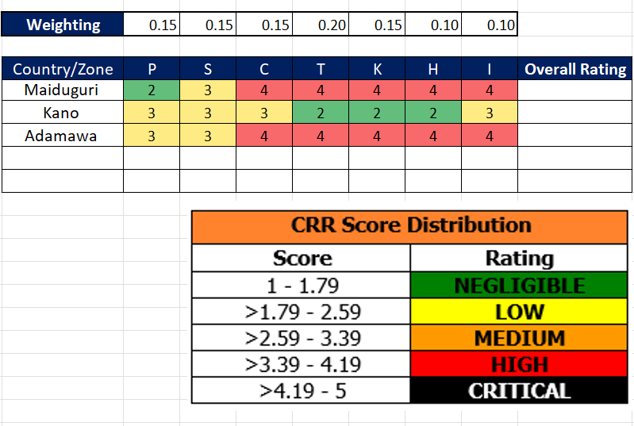
Risk Rating Calculation
Various organizations use different means to calculate a country risk rating or a location risk rating. Some use percentage system on three parameters while others use seven factors, do the summation and it give the average which corresponds to the risk level. Kindly see the two examples below.

Slide 22
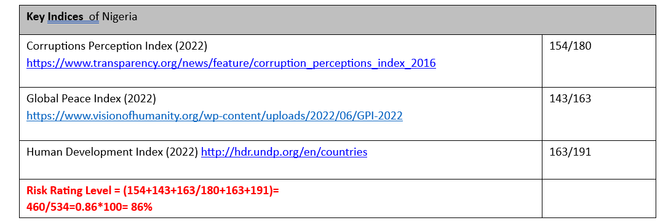
Risk Rating Calculation
Take the three indexes identified in the SRA (Corruptions Perception Index, Global Peace Index, and Human Development Index)
Divide the numerator by the denominator and times by 100 to give the percentage
Score accordingly in the Risk Level matrix

Slide 23
VIII. Periodicity of conducting SRA
Given the SRA is a live document, it needs to be conducted/updated on the following occasions :
- Before the commencement of a program or a new project
- When there is a major change in the country or location: military coup, revolution, kidnapping…..
- At least once per year depending on the country’s risk level
- When the organization wants to adjust security procedures
- After the relocation/evacuation before the reopening of the program

Slide 24
Periodicity of conducting SRA
Standard SRA | Green | Yellow | Orange | Red | Black
 | Developed and established, reviewed yearly | Reviewed 6-monthly, or on changes to SRA | Reviewed quarterly, or on changes to SRA | Reviewed regularly, or on changes to SRA | Reviewed regularly, or on changes to SRA

Slide 25
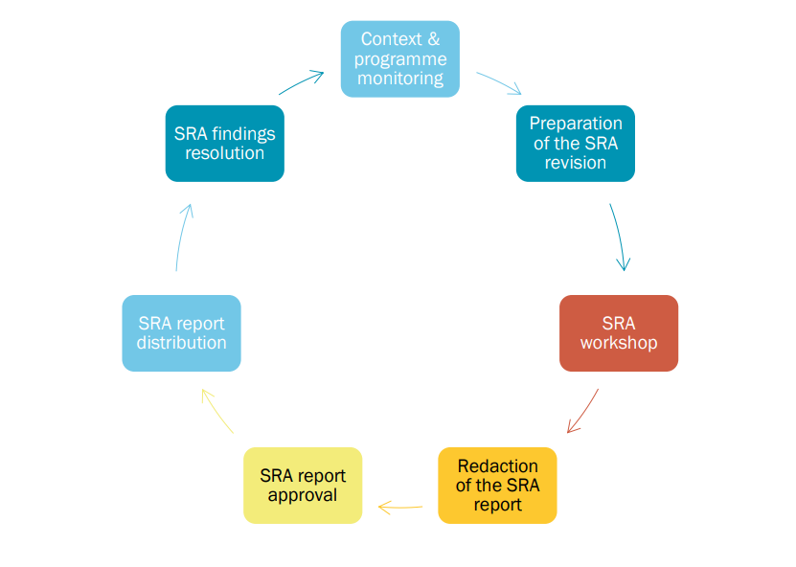
IX. The SRA Cycle:

Slide 26
The Approval Process
Notes:
When a security risk assessment is conducted by the country security officer (CSO), he has to submit it to the Global Security Manager for technical review before submitting to his country director and the Global Operations Manager respectively for first and final approval.
The determination of “acceptable risk” is a critical responsibility of senior managers within a Management System. The relationship between program criticality and the risk to personnel must be considered in the determination of acceptable risk. Therefore, Managers must constantly strive to balance these two critical functions and are accountable for creating a culture of security.
In conclusion, a permanent follow up of the implementation of the mitigation measures is a duty of all management, SMT, and security focal points. The use of the mitigation measures implementation Plan provides an easy tool for this purpose. Periodically the management and the SMT must advise and be advised on the status of implementation. Periodical briefings on the status of the implementation process must be included.

Slide 27
Summary and Questions
Notes:
The Security Risk Assessment is an important component of the overall management of risk. A detailed understanding of the risks in a specific context is essential if your organisation is to make more informed security decisions. Assessing risk must not be a one-off event. A continuous re-evaluation of all possible risks will help ensure that you have appropriate security measures in place at all times.
The security risk assessment process must be documented and include key findings and proposed measures to manage the different risks. Risk assessments must also be updated on a regular basis. In addition, staff will need guidance on what the different likelihood and impact ratings mean in order to analyse more accurately the various threats and to ensure consistency throughout the organization.
When considering vulnerability to threats both the specifics of the organisation and the individual should be considered. For example, role, age, gender, ethnicity, nationality and sexuality may all have an impact.

Slide 28
Bibliography
- https://gisf.ngo/wp-content/uploads/2015/09/EISF_Security-to-go_guide_Module-3_Risk-assessment-tool.pdf
- https://www.un.org/en/safety-and-security/risk-management#:~:text=Security%20Risk%20Management%20(SRM)%20is,security%20personnel%20on
-https://www.un.org/sites/un2.un.org/files/2021/03/undss-do_handbook_2020.pdf
-NRC Risk Security Management
- World Vision International Security Risk Management Manual
-Operational Security in violent environment
-https://www.visionofhumanity.org/maps/#/
-https://www.transparency.org/en/cpi/2022
-https://hdr.undp.org/content/human-development-report-2021-22

Slide 29
THANK YOU FOR YOUR TIME

